Slide 1

Azure in Depth
4NET
SUPINFO Official Document
Notes:
© SUPINFO International University - http://www.supinfo.com
SUPINFO vous permet de partager ce document
Vous êtes libre de :
Partager — reproduire, distribuer et communiquer ce document Remixer — modifier ce document
A condition de respecter les règles suivantes :
Indication obligatoire de la paternité — Vous devez obligatoirement préciser l’origine « SUPINFO » du document au début de celui-ci de la même manière qu’indiqué par SUPINFO International University – Notamment en laissant obligatoirement la première et la dernière page du document, mais pas d'une manière qui suggérerait que SUPINFO International University vous soutiennent ou approuvent votre utilisation du document, surtout si vous le modifiez. Dans ce dernier cas, il vous faudra obligatoirement supprimer le texte « SUPINFO Official Document » en tête de page et préciser notamment la page indiquant votre identité et les modifications principales apportées.
En dehors de ces dispositions, aucune autre modification de la première et de la dernière page du document n’est autorisée.
NOTE IMPORTANTE : Ce document est mis à disposition selon le contrat CC-BY-NC-SA Creative Commons disponible en ligne http://creativecommons.org/licenses ou par courrier postal à Creative Commons, 171 Second Street, Suite 300, San Francisco, California 94105, USA modifié en ce sens que la première et la dernière page du document ne peuvent être supprimées en cas de reproduction, distribution, communication ou modification. Vous pouvez donc reproduire, remixer, arranger et adapter ce document à des fins non commerciales tant que vous respectez les règles de paternité et que les nouveaux documents sont protégés selon des termes identiques. Les autorisations au-delà du champ de cette licence peuvent être obtenues à support@supinfo.com.
© SUPINFO International University – EDUCINVEST - Rue Ducale, 29 - 1000 Brussels Belgium . www.supinfo.com

Slide 2

Objectives
Azure in Depth
By completing this course, you’ll be able to:
Use Azure Emulator
Handle and interact with Blob storage
Create and use Worker Roles

Slide 3


Course plan
Azure in Depth
Azure Emulator
Azure Storage
Blob Storage
Azure Cloud Services
Focus on Worker Roles

Slide 4
Azure eMULATOR
Azure in Depth

Slide 5

Introduction
Azure Emulator
Allows to develop locally Azure elements
Almost no difference between it and the real “Azure”
For this course, we’ll focus on two things:
Azure Storage
Azure Cloud Service (particularly Worker Roles)

Slide 6
Why an emulator?
Azure Emulator
Azure Cloud system is a professional solution
Not free of charge
Credit card asked
Azure emulator is fully compliant with our works

Slide 7
Download
Azure Emulator
Azure SDK found at:
https://azure.microsoft.com/fr-fr/downloads/
WebPI will install necessary elements in VS
Notes:
WebPI = Web Platform Installer

Slide 8
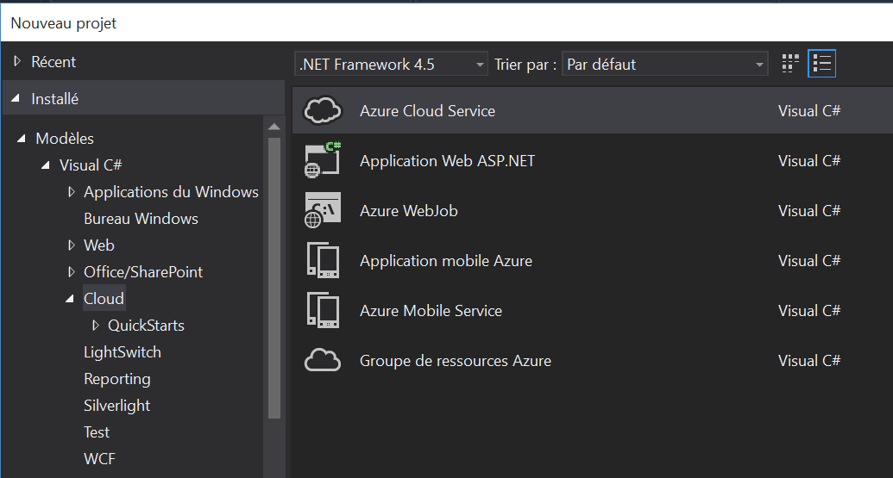
Does it work?
Azure Emulator

Slide 9

Azure Storage
Azure in Depth

Slide 10
Windows Azure Storage
Storage
Storage in the Cloud
Scalable, Durable, Available
Anywhere at anytime
Ge-redundant / Locally redundant storage
Exposed visa RESTful Web Services
Use from Windows Azure Compute (Execution Model)
Use from anywhere on the internet
Notes:
Geo-redundant storage provides the highest level of storage durability by seamlessly replicating your data to a secondary location within the same region
Locally redundant storage provides highly durable and available storage within a single location.
Microsoft monitors the service, provides patches, handles scaling, and does the other work needed to keep the service available.

Slide 11



Windows Azure Storage Account
Storage
User can choose geo-location to host storage account:
US
Europe
Asia
North Central US
Northern Europe
Western Europe
East Asia
West US
East US
South Central US
South East Asia

Slide 12
Windows Azure Storage
Storage
Can CDN Enable Account
Blobs delivered via 24 global CDN nodes
Can co-locate storage account with compute account
Explicitly or using affinity groups
Accounts have two independent 512 bit share secret keys
100 TBs per account
Notes:
The Windows Azure Content Delivery Network (CDN) offers developers a global solution for delivering high-bandwidth content by caching blobs and static content of compute instances at physical nodes in the United States, Europe, Asia, Australia and South America.
A Windows Azure subscription contains storage accounts
Can explicitly geo-locate to a sub region or set affinity with other services
Can enable CDN at the account level (means that public containers will be retrievable via the CDN URL)
100 TBs per account means a lot of storage for very little cost
You should change the access keys to your storage account periodically to help keep your storage connections more secure. Two access keys are assigned to enable you to maintain connections to the storage account using one access key while you regenerate the other access key.

Slide 13
Storage Client API
Storage
Storage Libraries in Many Languages
C#/.NET
Python
Ruby
Perl
JavaScript (Node)
Java
PHP
Erlang
Common LISP
Objective-C
C#/VB on Windows Phone 7
Notes:
Programmatic access to the Blob, Queue, and Table services is available via the Windows Azure client libraries and the Windows Azure storage services REST API.

Slide 14
Windows Azure Storage
Storage
Windows Azure Storage provides simple security for calls to storage service
HTTPS endpoints (only HTTP in emulator)
Digitally sign request for privileged operations
Two 512 bit symmetric keys per storage account
Can be regenerated independently
More granular security via Share Access Signatures
Notes:
Simple shared secret security
Can use HTTP or HTTPS to access
Use HTTP for public content
Use HTTPS for secure content (i.e. where using es or Shared Access Signatures)
Two 512bit keys
Keys used to sign priv requests
Two keys supports rolling of keys
E.g. if one key is compromised can use the second key while first is regenerated
More on SAS’s after

Slide 15
Windows Azure Storage Abstractions
Storage
Blobs
Simple named files along with metadata for the file.
Drives
Durable NTFS volumes for Windows Azure applications to use. Based on Blobs.
Tables
Structured storage. A table is a set of entities; an entity is a set of properties.
Queues
Reliable storage and delivery of messages for an application.

Slide 16


Questions?

Slide 17

Blob Storage
Azure in Depth

Slide 18
Focus on Blob Storage
Blob Storage
Blobs
Simple named files along with metadata for the file.

Slide 19
Concepts
Blob Storage
Blob service provides storage for entities
Binary files and text Files
Exposed by REST API and exposes two resources :
Containers (set of blobs)
Blobs (every blob belongs to a container)

Slide 20
Concepts
Blob Storage
Two types of blobs
Block Blobs : Optimized for streaming (hash key MD5, )
Object < 64Mo : one write operation
Object > 64Mo : one block of 4Mo x X(blocks) = (Object size). Maximum 50000 blocks (⬄ 200Go)
Page blobs : Optimized for random read/write operations with possibility to write a range of bytes in blobs
Set of pages of 512o.
Can update single page, or multiple (max 4Mo)
More information : https://msdn.microsoft.com/fr-fr/library/azure/ee691964.aspx

Slide 21
Concepts
Blob Storage
Blobs are read by calling the Get Blob operation
A client may read entire blob or an arbitrary range of bytes
Block Blobs less than or equal to 64MB can be uploaded by calling the Put Blob Operation
Block Blobs larger than 64MB must be uploaded as a set of blocks, each which must be less than or equal to 4 MB
Page Blobs are created and initialized with a maximum size with a call to Put Blob (Max size 1TB)
Notes:
More info: http://msdn.microsoft.com/en-us/library/dd573356.aspx
http://msdn.microsoft.com/en-us/library/dd135733.aspx
Using the REST API for the Blob service, you can create a hierarchical namespace similar to a file system. Blob names may encode a hierarchy by using a configurable path separator.
For example, the blob names MyGroup/MyBlob1 and MyGroup/MyBlob2 imply a virtual level of organization for blobs.
The enumeration operation for blobs supports traversing the virtual hierarchy in a manner similar to that of a file system, so that you can return a set of blobs that are organized beneath a group. For example, you can enumerate all blobs organized under MyGroup/.

Slide 22
Windows Azure API
Blob Storage
http://<account>.blob.core.windows.net/<container>/<blobname>
Account
Container
Blob
Pages/ Blocks
PIC01.JPG
images
Block/Page
PIC02.JPG
contoso
Block/Page
videos
VID1.AVI
Notes:
Note: This kind of URL is reachable with a Windows Azure account, which isn’t available for this course. See later for Windows Azure Emulator URL

Slide 23
Main Web Service Operations
Blob Storage
PutBlob
GetBlob
DeleteBlob
CopyBlob
SnapshotBlob
LeaseBlob
Notes:
Put Blob - Creates a new blob or replaces an existing blob within a container.
Get Blob - Reads or downloads a blob from the system, including its metadata and properties.
Delete Blob - Deletes a blob
Copy Blob - Copies a source blob to a destination blob within the same storage account.
SnapShot Blob - The Snapshot Blob operation creates a read-only snapshot of a blob.
Lease Blob - Establishes an exclusive one-minute write lock on a blob. To write to a locked blob, a client must provide a lease ID.
Using the REST API for the Blob service, developers can create a hierarchical namespace similar to a file system.
Blob names may encode a hierarchy by using a configurable path separator. For example, the blob names MyGroup/MyBlob1 and MyGroup/MyBlob2 imply a virtual level of organization for blobs.
The enumeration operation for blobs supports traversing the virtual hierarchy in a manner similar to that of a file system, so that you can return a set of blobs that are organized beneath a group.
For example, you can enumerate all blobs organized under MyGroup/.
The Blob service provides storage for entities, such as binary files and text files. The REST API for the Blob service exposes two resources: containers and blobs. A container is a set of blobs; every blob must belong to a container. The Blob service defines two types of blobs:
Block blobs, which are optimized for streaming. This type of blob is the only blob type available with versions prior to 2009-09-19.
Page blobs, which are optimized for random read/write operations and which provide the ability to write to a range of bytes in a blob. Page blobs are available only with version 2009-09-19.
Containers and blobs support user-defined metadata in the form of name-value pairs specified as headers on a request operation.
A block blob may be created in one of two ways. Block blobs less than or equal to 64 MB in size can be uploaded by calling the Put Blob operation. Block blobs larger than 64 MB must be uploaded as a set of blocks, each of which must be less than or equal to 4 MB in size. A set of successfully uploaded blocks can be assembled in a specified order into a single contiguous blob by calling Put Block List. The maximum size currently supported for a block blob is 200 GB.
Page blobs are created and initialized with a maximum size with a call to Put Blob. To write content to a page blob, you call the Put Page operation. The maximum size currently supported for a page blob is 1 TB.
Blobs support conditional update operations that may be useful for concurrency control and efficient uploading.
Blobs can be read by calling the Get Blob operation. A client may read the entire blob, or an arbitrary range of bytes.

Slide 24
Associate Metadata with Blob
Blob Storage
Standard HTTP metadata/headers (Cache-Control, Content-Encoding, Content-Type, etc)
Metadata is <name, value> pairs, up to 8KB per blob
Either as part of PutBlob or independently

Slide 25
Blob always accessed by name
Blob Storage
Can include ‘/‘ or other delimeter in name ex : /<container>/myblobs/blob.jpg

Slide 26
Containers
Blob Storage
Multiple Containers per Account
Special $root container
Blob Container
A container holds a set of blobs
Set access policies at the container level
Associate Metadata with Container
List the blobs in a container
Including Blob Metadata and MD5
NO search/query
No WHERE MetadataValue = ?
Notes:
Account can contain unlimited number of containers
Root container useful when serving Silverlight and flash out of Blob storage. May need to store Cross domain access policy files in root of the domain
Metadata is up to 8KB of name value pairs per container
A root container serves as a default container for your storage account. A storage account may have one root container. The root container must be explicitly created and must be named $root.
A blob stored in the root container may be addressed without referencing the root container name, so that a blob can be addressed at the top level of the storage account hierarchy.

Slide 27
Containers
Blob Storage
Let’s create and use containers together!
The following slides will be a step-by-step blob storage discovery

Slide 28
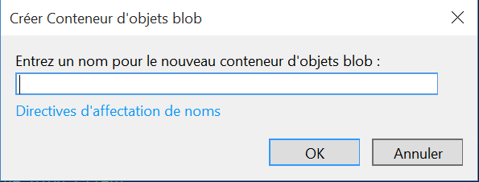
Create a Container
Blob Storage
Open the “Server Explorer”
Deploy the “Azure (not connected)” root element (Affichage -> Explorateur de serveurs). Proceed with Supinfo address (no need to have an “abonnements”)
Deploy “Storage” -> “Development” element
Right click on “Blob objects” and select “Create”

Slide 29
Create a Container
Blob Storage
Please name it “mycontainer”
Naming rules:
Name must start with a lowercase char or a number
Advised to use only lowercase chars and numbers
Max 1024 characters, case sensitive

Slide 30
Create a Container
Blob Storage
By default, containers are private
Can’t access it by HTTP
To change this behavior, access container Properties
Find the “Public Read Access” option
Change it from “Off” to “Container”

Slide 31
Access a Container
Blob Storage
Your container is created, let’s access it
Right-click on your Blob container
Select “Display”
Some controls are available (see next slide)

Slide 32
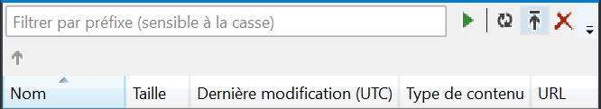
Access a Container
Blob Storage
Delete a file
Upload a file
Refresh display
Execute filter
Define filter

Slide 33
Upload a File
Blob Storage
Find a file on your computer
Choose a brower-compatible one, such as pictures/raw-text
Upload it to your container
Upload another by specifying the folder “Thumbnails”

Slide 34
Upload a File
Blob Storage
Select a file and access its Properties
You’ll find the “URL” property
Copy its value and paste it in your browser
You should be able to access your file!

Slide 35
Access a File
Blob Storage
Select a file and access its Properties
You’ll find the “URL” property
Copy its value and paste it in your browser
You should be able to access your file!

Slide 36
Access a Container
Blob Storage
Container also have some dedicated URL
Browse the container
http://127.0.0.1:10000/devstoreaccount1/mycontainer/?comp=list
Browse a folder
http://127.0.0.1:10000/devstoreaccount1/mycontainer/?comp=list&prefix=Thumbnails
Add maxResults parameter to limit results

Slide 37
Note about Containers
Blob Storage
In fact, folders doesn’t exist
Files only have « Prefixes »
It’s just a one depth level system
Prefixes allows us to emulate folder systems

Slide 38
Two Types of Blobs Under the Hood
Blob Storage
Block Blob
Targeted at streaming workloads
Each blob consists of a sequence of blocks
Each block is identified by a Block ID
Size limit 200GB per blob
Optimistic Concurrency via Etags
Page Blob
Targeted at random read/write workloads
Each blob consists of an array of pages
Each page is identified by its offset from the start of the blob
Size limit 1TB per blob
Optimistic or Pessimistic (locking) concurrency via leases
Notes:
Block blobs are comprised of blocks, each of which is identified by a block ID.
You create or modify a block blob by uploading a set of blocks and committing them by their block IDs.
If you are uploading a block blob that is no more than 64 MB in size, you can also upload it in its entirety with a single Put Blob operation.
When you upload a block to Windows Azure using the Put Block operation, it is associated with the specified block blob, but it does not become part of the blob until you call the Put Block List operation and include the block's ID.
The block remains in an uncommitted state until it is specifically committed. Writing to a block blob is thus always a two-step process.
Each block can be a maximum of 4 MB in size. The maximum size for a block blob in version 2009-09-19 is 200 GB, or up to 50,000 blocks.
Page blobs are a collection of pages.
A page is a range of data that is identified by its offset from the start of the blob.
To create a page blob, you initialize the page blob by calling Put Blob and specifying its maximum size.
To add content to or update a page blob, you call the Put Page operation to modify a page or range of pages by specifying an offset and range. All pages must align 512-byte page boundaries.
Unlike writes to block blobs, writes to page blobs happen in-place and are immediately committed to the blob.
The maximum size for a page blob is 1 TB.
A page written to a page blob may be up to 1 TB in size but will typically be much smaller

Slide 39
And reality…
Blob Storage

Slide 40
Questions?

Slide 41
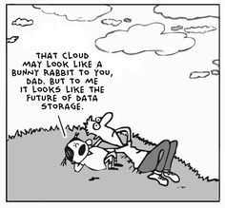
Cloud Services
Azure in Depth

Slide 42
Introduction
Cloud Services
Allows you to create Services
As in « Windows Services »
Somehow like « Linux Daemons »
Many services for your needs…
Found in « Azure Cloud Service » in VS

Slide 43
Introduction
Cloud Services
Azure Cloud Services:
ASP.NET Web Role:
Able to manage one or several ASP.NET Web Sites with a role
WCF Service Web Role:
Able to manage one or several WCF Services with a role
Worker Role:
Works as a background task

Slide 44
Introduction
Cloud Services
Azure Cloud Services:
Cache Worker Role:
Similar as Worker Role but for caching purposes
Service Bus Worker Role:
Get messages from a bus queue to handle requests

Slide 45
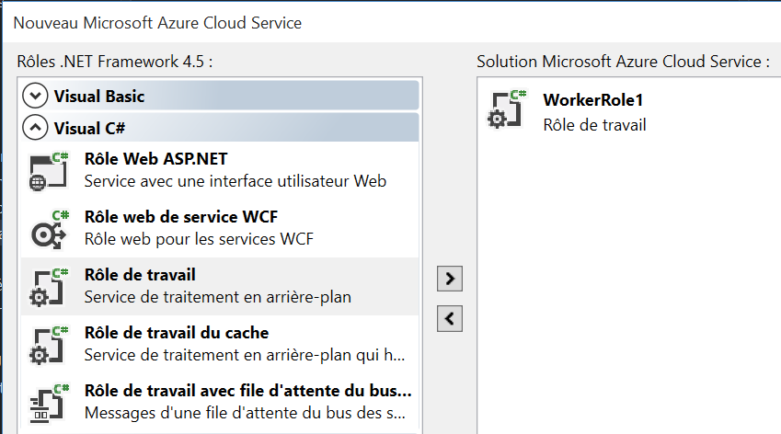
Introduction
Cloud Services
In this course, we’ll see Worker Roles
Convenient way to process background tasks
Simple C# project…
With some namespaces to handle requests

Slide 46
Focus on Worker Roles
Azure in Depth

Slide 47
Introduction
Focus on Worker Roles
Event Methods:
Run()
As a thread, starting point for your Worker Role
Takes in account a CancellationToken in case of emergency stop
Launch the RunAsync() method, asynchronously

Slide 48
Introduction
Focus on Worker Roles
Event Methods:
OnStart()
Event executed before even run the project
Setup Worker Role properties, such as maximum connections
OnStop()
Event as service end
Close data access and handle CancellationToken

Slide 49
Introduction
Focus on Worker Roles
Class Method:
RunAsync()
Called by the Run() method and execute business code
This is where your code is
Takes the CancellationToken as parameter to take it in account
Run with a while in it

Slide 50
Worker Start & Execution
Focus on Worker Roles
Run()
RunAsync()
OnStart()
Start Worker
OnStop()

Slide 51
Worker Execution & Stop
Focus on Worker Roles
Run()
RunAsync()
OnStart()
CancellationToken
OnStop()

Slide 52

Connect to Azure Storage
Focus on Worker Roles
When creating a new Azure Cloud Service…
Select Worker Role and add it to your project
You’ll see two projects:
Azure Cloud Service
Worker Role Project

Slide 53
Connect to Azure Storage
Focus on Worker Roles
Azure Cloud Service contains some configuration files
ServiceConfiguration
Local: For local config
Cloud: When publishing into cloud
ServiceDefinition
To store properties accessible in ServiceConfiguration

Slide 54
Connect to Azure Storage
Focus on Worker Roles
Worker Roles contains:
App.config
For global configuration
Packages.config
As many .NET projects, set needed packages (such as EF and Azure)
WorkerRole.cs
Where the code is written

Slide 55
Connect to Azure Storage
Focus on Worker Roles
To connect Azure Storage in a Worker Role, you need:
To include Windows Azure packages
Right click on your Worker references
Click on Manage NuGet Packages…
Type Windows Azure in the top-right corner
Install Windows Azure Storage & Cloud Configuration Manager

Slide 56
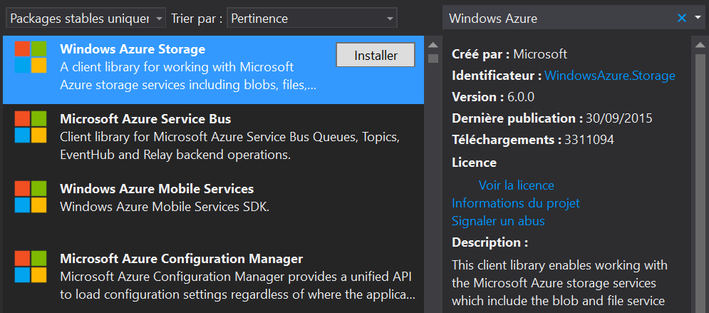
Connect to Azure Storage
Focus on Worker Roles
Notes:
Just in case some namespaces still aren’t available (for example Microsoft.WindowsAzure.ServiceRuntime and Microsoft.WindowsAzure.Diagnostics), right click on project referencies, select « Add a reference… »
Then select on the left pane « Extensions » and find these namespaces in the list. Tick checkboxes and voila!

Slide 57
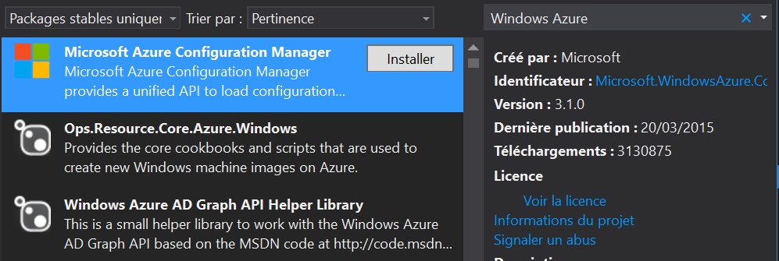
Connect to Azure Storage
Focus on Worker Roles
Notes:
Just in case some namespaces still aren’t available (for example Microsoft.WindowsAzure.ServiceRuntime and Microsoft.WindowsAzure.Diagnostics), right click on project referencies, select « Add a reference… »
Then select on the left pane « Extensions » and find these namespaces in the list. Tick checkboxes and voila!

Slide 58
Connect to Azure Storage
Focus on Worker Roles
To connect Azure Storage in a Worker Role, you need:
Your CloudStorageAccount
CloudStorageAccount storageAccount = CloudStorageAccount.Parse(
CloudConfigurationManager.GetSetting(
"Microsoft.WindowsAzure.Plugins.Diagnostics.ConnectionString"
)
);
Configuration parameter in ServiceConfiguration.Local.cscfg
Notes:
This property MUST be equal to:
<Setting name="Microsoft.WindowsAzure.Plugins.Diagnostics.ConnectionString" value="UseDevelopmentStorage=true" />

Slide 59
Blob Storage Management
Focus on Worker Roles
We’ll access to our Blob Storage with this worker!
How to:
Access the Blob Storage
// Create the blob client.
CloudBlobClient blobClient = storageAccount.CreateCloudBlobClient();

Slide 60
Blob Storage Management
Focus on Worker Roles
How to:
Get the container reference
// Retrieve a reference to a container.
CloudBlobContainer container = blobClient.GetContainerReference("ContainerName");

Slide 61
Blob Storage Management
Focus on Worker Roles
How to:
Get folders and files references
CloudBlobDirectory dir =
(CloudBlobDirectory)container
.GetDirectoryReference("FolderName");
CloudBlockBlob img =
(CloudBlockBlob)container
.GetBlobReferenceFromServer("FileName");

Slide 62
Useful methods
Focus on Worker Roles
Other useful methods:
Instances | Method
CloudBlobContainer CloudBlockBlob | Exists()
CloudBlobContainer | CreateIfNotExists()
CloudBlobContainer CloudBlobDirectory | GetBlobReference(filename)
CloudBlobContainer CloudBlobDirectory | ListBlobs()

Slide 63
Useful methods
Focus on Worker Roles
Other useful methods:
Instances | Method
CloudBlockBlob | StartCopyFromBlob(Blob)
CloudBlockBlob | UploadFromFile(path, AccessMode)
CloudBlockBlob | DownloadToFile(path, AccessMode)
CloudBlockBlob | Delete()

Slide 64
Final notes
Focus on Worker Roles
Notice many methods have Begin and End prefix
Asynchronous tasks
Notice the following code in your Worker
Use it to execute your code every x seconds
You shouldn’t remove it ☺
await Task.Delay(1000);

Slide 65
Blob Storage Management
Focus on Worker Roles
Example1: Iterate through blobs in a folder
// ...BlobClient and BlobContainer already retrieved...
CloudBlobDirectory dir =
(CloudBlobDirectory)container
.GetDirectoryReference("FolderName");
var list = container.ListBlobs();
foreach (IListBlobItem item in list) {
var type = item.GetType();
if (type == typeof(CloudBlockBlob)) /* ... */
else if (type == typeof(CloudPageBlob)) /* ... */
else if (type == typeof(CloudBlobDirectory)) /* ... */
}

Slide 66
Blob Storage Management
Focus on Worker Roles
Example2: Copy blob
// ...BlobClient already retrieved...
CloudBlobContainer container = blobClient.GetContainerReference("ContainerName");
CloudBlockBlob img = (CloudBlockBlob)container
.GetBlobReferenceFromServer("File1");
CloudBlockBlob img2 = (CloudBlockBlob)dir
.GetBlockBlobReference("File2");
if (!imgThumb.Exists()) {
img2.StartCopyFromBlob(img);
}

Slide 67
Blob Storage Management
Focus on Worker Roles
More information :
https://azure.microsoft.com/fr-fr/documentation/articles/storage-dotnet-how-to-use-blobs

Slide 68
Questions?

Slide 69

Exercises
Azure in Depth
Connect to your Blob Storage
Implement the following actions:
Upload a file from your local system
Download a file to your local system
Create a folder in the Blob Storage
Copy a file in the Blob Storage
List every Blobs in the Blob Storage (use the container to do so)

Slide 70

The End
Azure in Depth
That’s all folks!

